Slide 1

ECOMMERCE – BULKY BOOK Website
Nikhitha Athukuri

Slide 2
TOPICS COVERED
Entity Framework Core
CRUD Operations – with foreign key relations
Client Server Validations
TempData / Toastr Notifications , DataTables
Rich text Editors (Tiny)
Payment Gateway (Stripe)
User Management – Identity Package
Social logins (Third party Logins)

Slide 3
TOOLS REQUIRED
Visual Studio(.Net framework)
Sql Server
Postman

Slide 4
TOOLS NEEDED
.NET 7
VISUAL STUDIO 2022
SSMS 2018

Slide 5
BUILT IN DEPENDENCY INJECTION
CROSS PLATFORM
EASY UPDATES
ASP.NET CORE
FAST AND OPEN SOURCE
CLOUD FRIENDLY
PERFORMANCE

Slide 6
BULKY BOOK Overview
N-Tier Architecture
Repository Pattern and UnitOfWork
TempData/ViewBag/ViewData in .NET core
SweetAlerts, Rich Text Editor and DataTables with .NET Core
Scaffold Identity (Razor Class Library)
Roles and Authorization in .NET Core
Stripe Payment/Refund with .NET Core
Session in .NET Core
User Management
Social Login using Facebook
View Components in .NET Core

Slide 7
DEPENDENCY INJECTION

Slide 8



With out DP
Page 1
Db dbObj = new Db()
Email
Email emailObj = new Email()
Page 2
Email emailObj = new Email()
Db dbObj = new Db()
Page 3
Database
Email emailObj = new Email()
Db dbObj = new Db()

Slide 9
With DP
Page 1
IDb
Email
IEmail
IEmail,Email
IEmail
Page 2
DI
CONTAINER
IDb
IDb,Db
Page 3
IEmail
Database
IDb

Slide 10



.Net Core Pipe Line
Request from Browser
Auth
MVC
Static Files

Slide 11
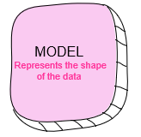
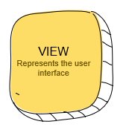
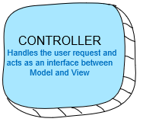
MVC ARCHITECTURE
2. Get Data
3. Get Presentation
USER CLICKS
1. Request
4. Response

Slide 12
APPSETTINGS.JSON
All of the application’s settings are contained in a file named as appsettings.json (Database connections, secret keys, Allowing hosts..)
Any changes to the appsettings.json file will require restarting the “Microsoft IIS Administration” service to take effect.

Slide 13
TAG HELPERS
Tag Helpers are introduced with ASP.NET Core
Tag Helpers enable server-side code to participate in creating and rendering HTML elements in Razor files.
Tag helpers are a new feature and similar to HTML helpers, which help us render HTML.
They are more focused around HTML tags and much more easier to use with HTML.

Slide 14
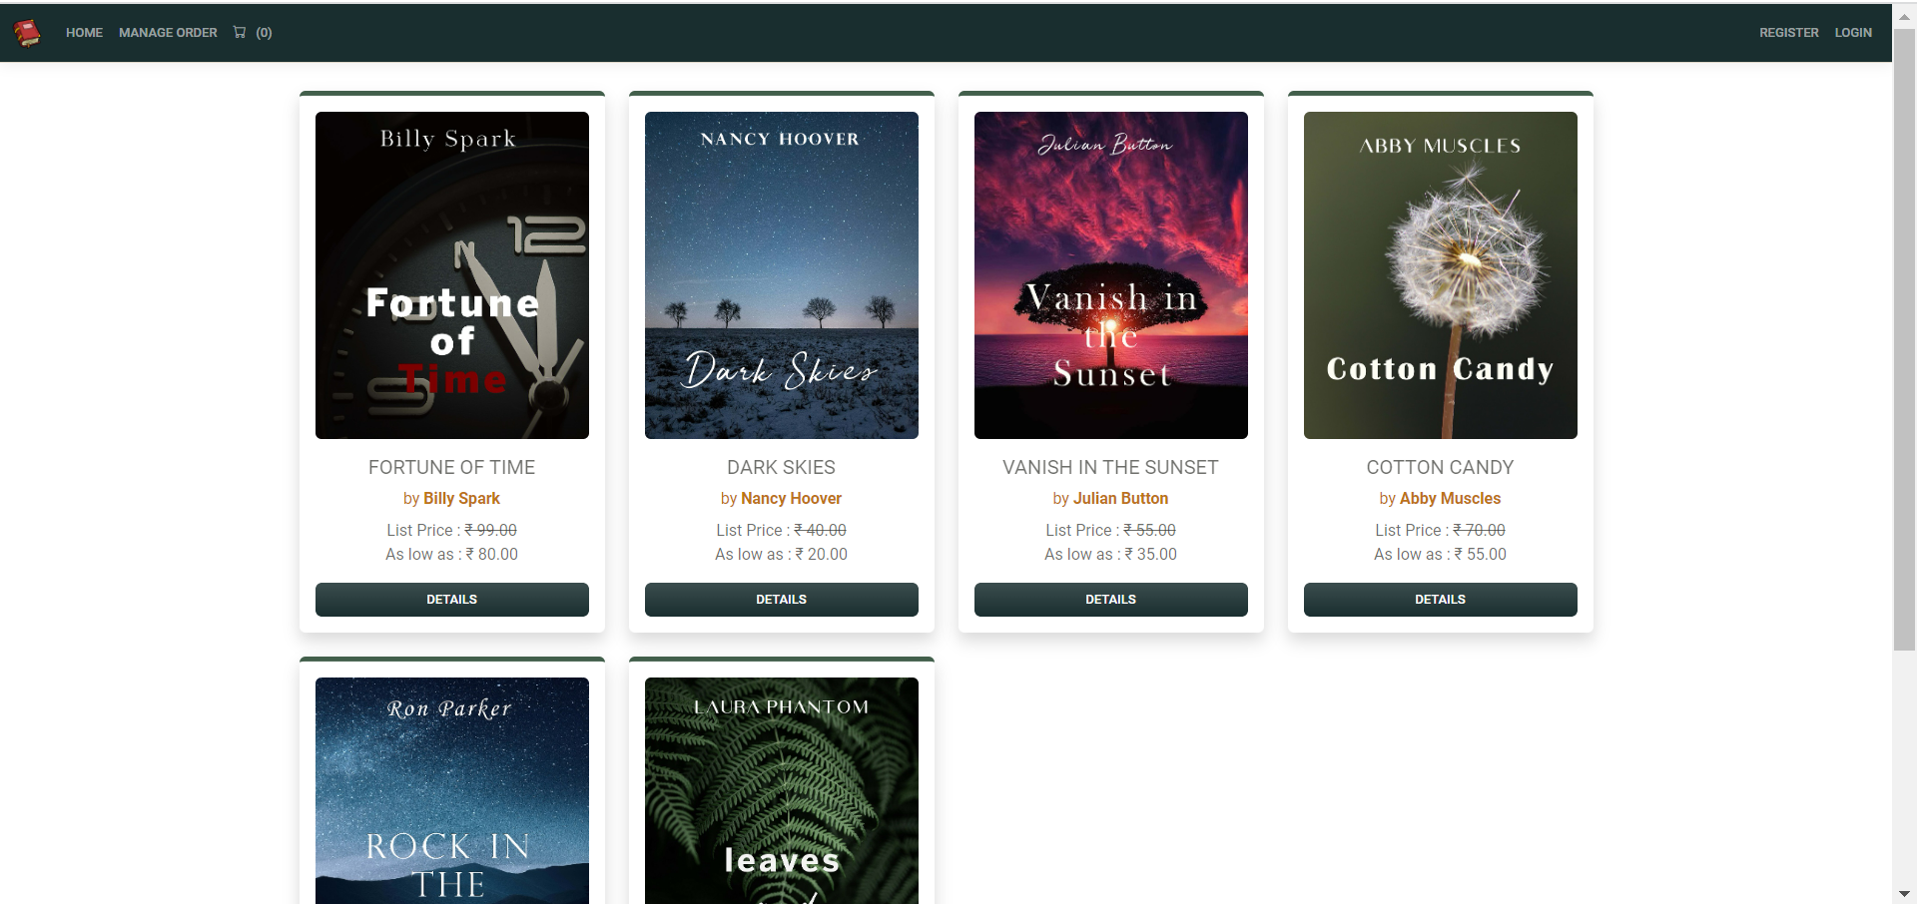
PRODUCT
Outputs : Home Page
CATEGORY
APPLICATIONTYPE

Slide 15
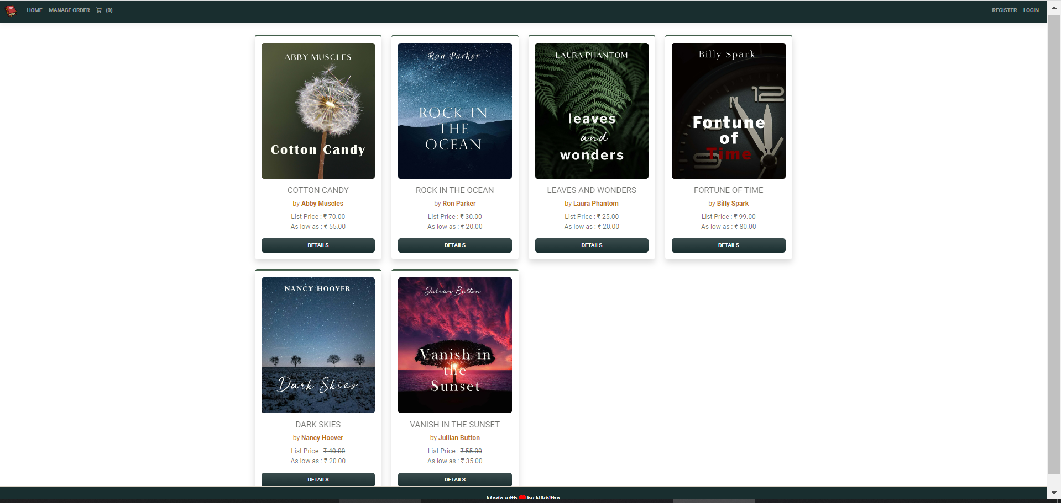

Slide 16
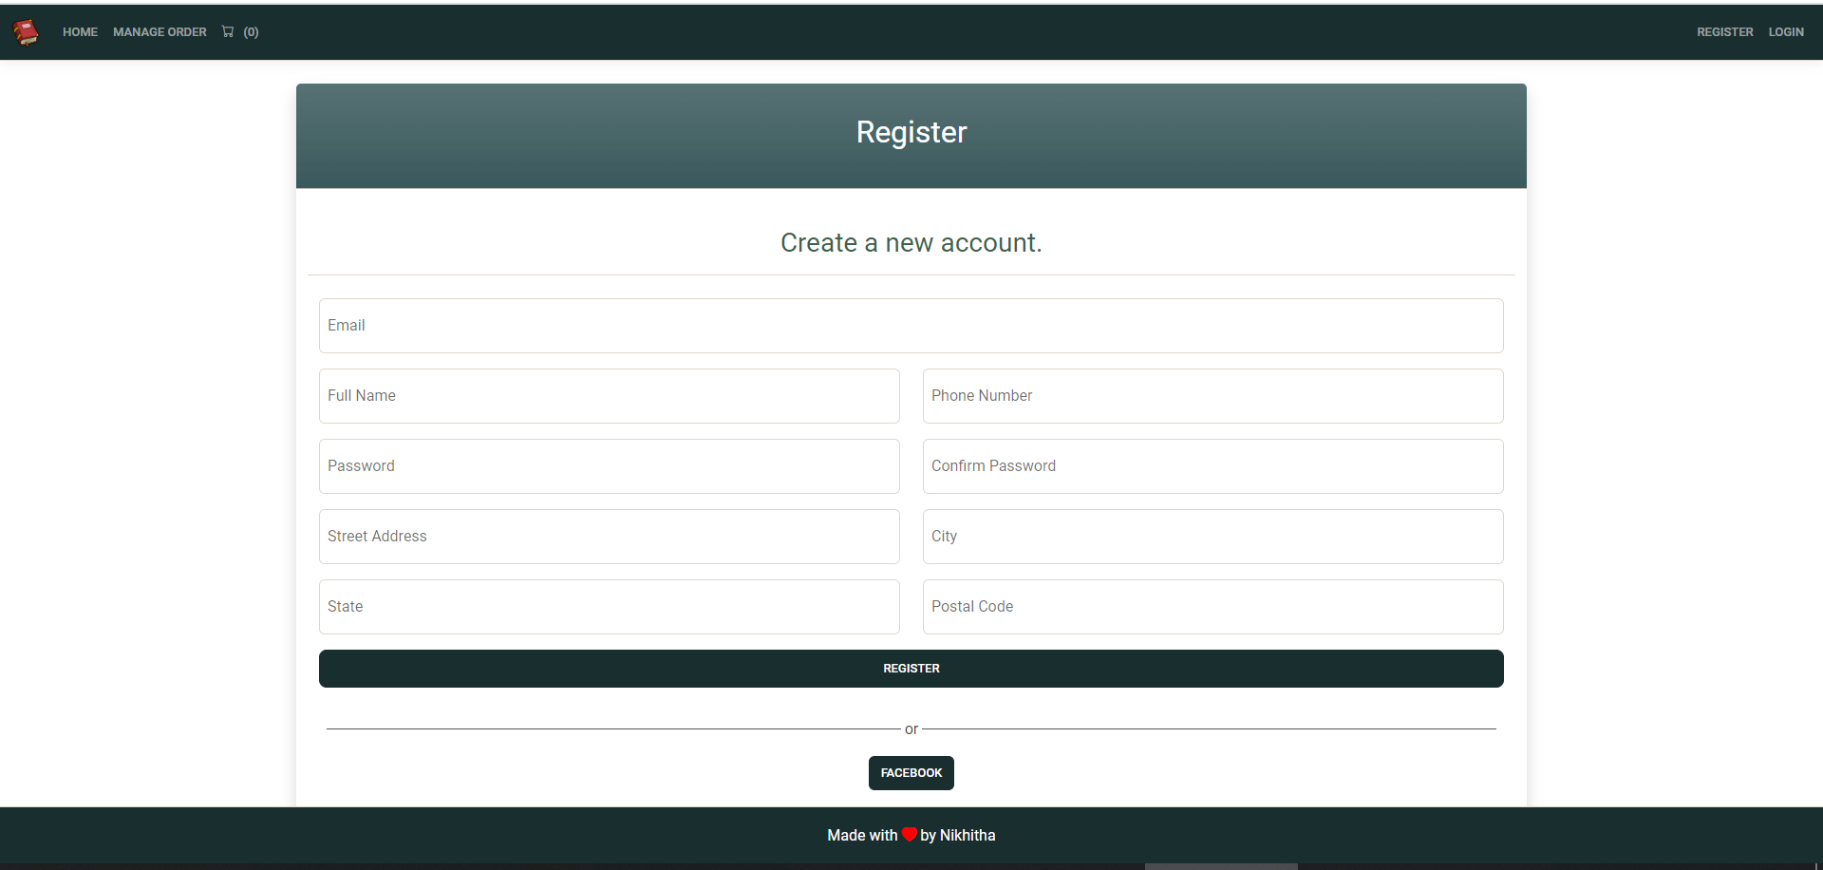
Register Page

Slide 17
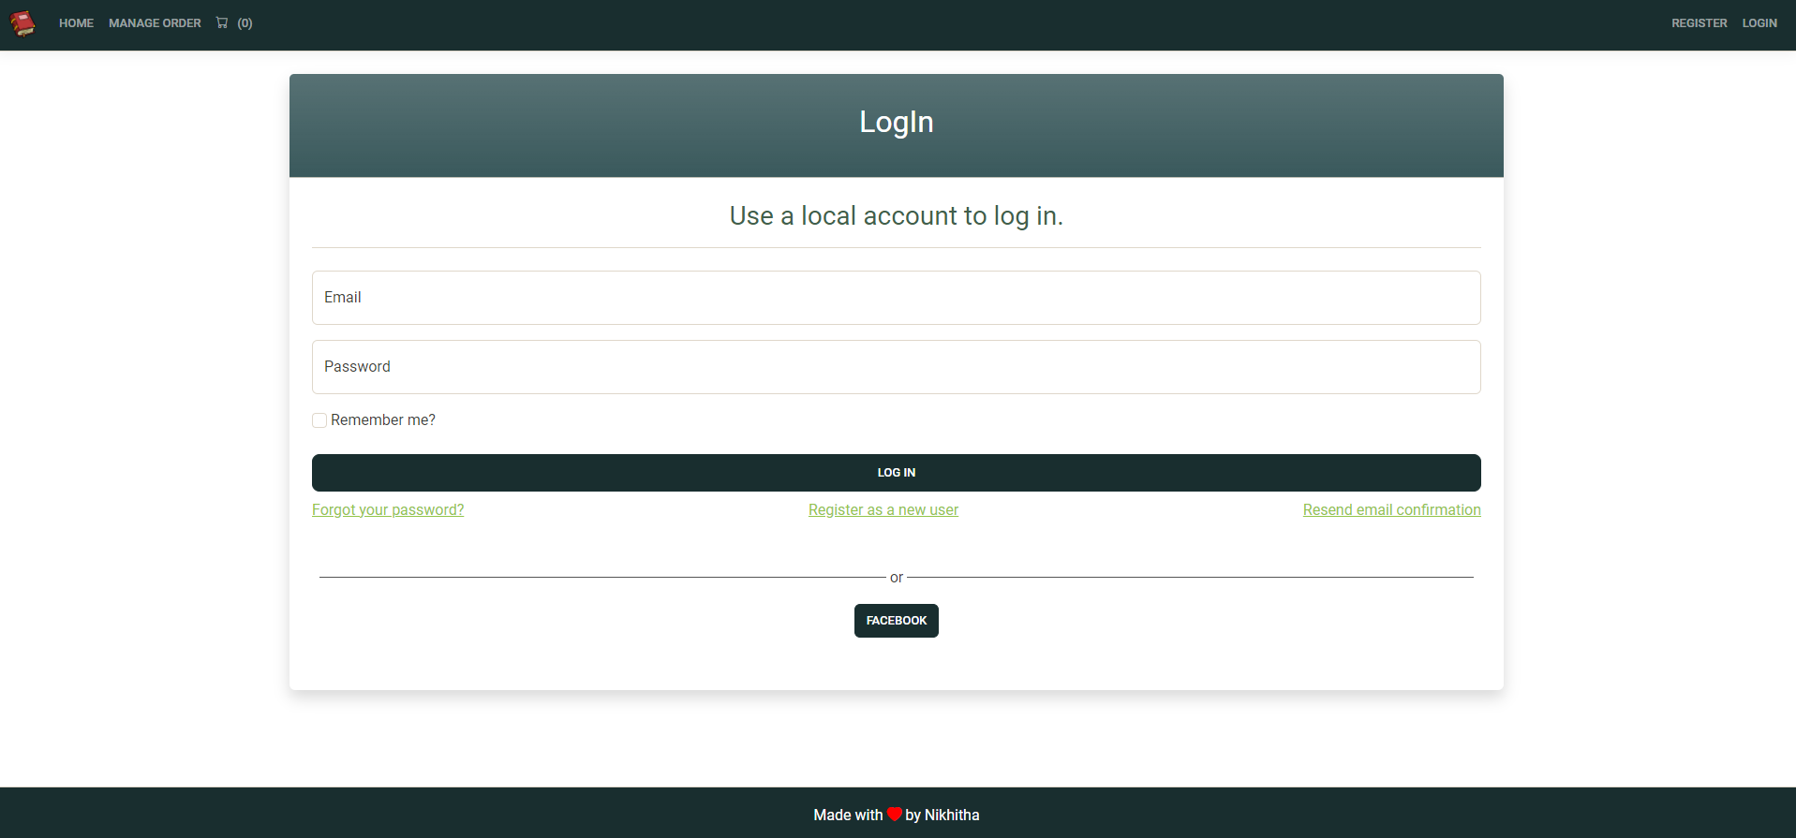
Login Page

Slide 18
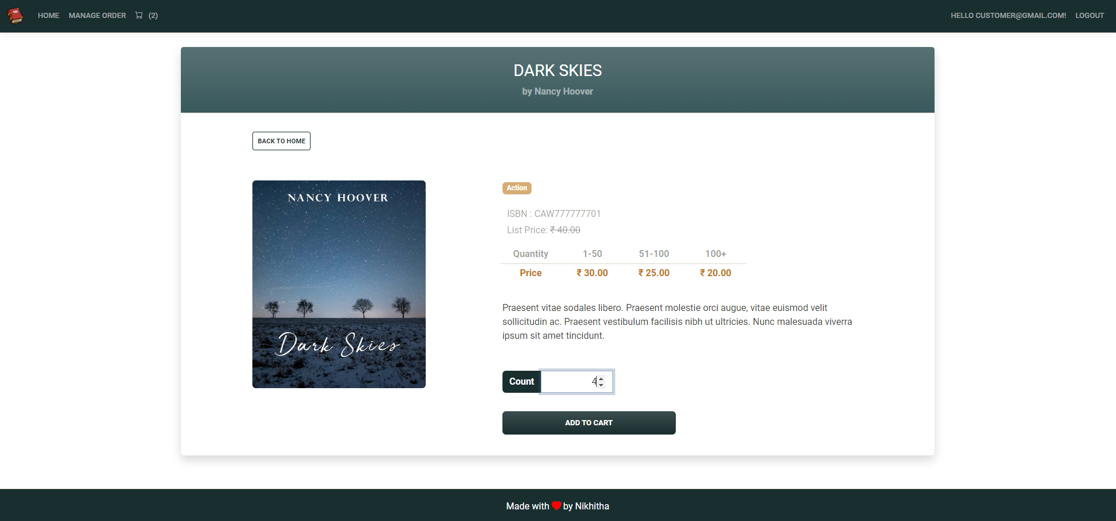
Logged In as Customer : Details of each product – Details Page

Slide 19
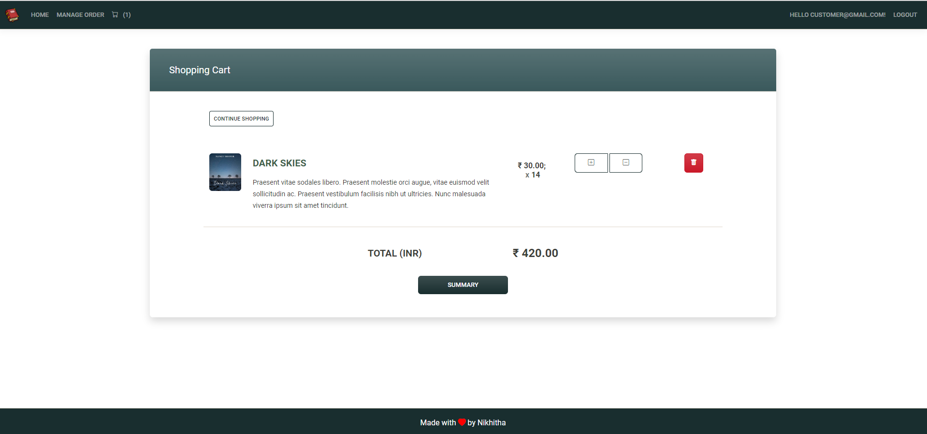
Shopping Cart Page

Slide 20
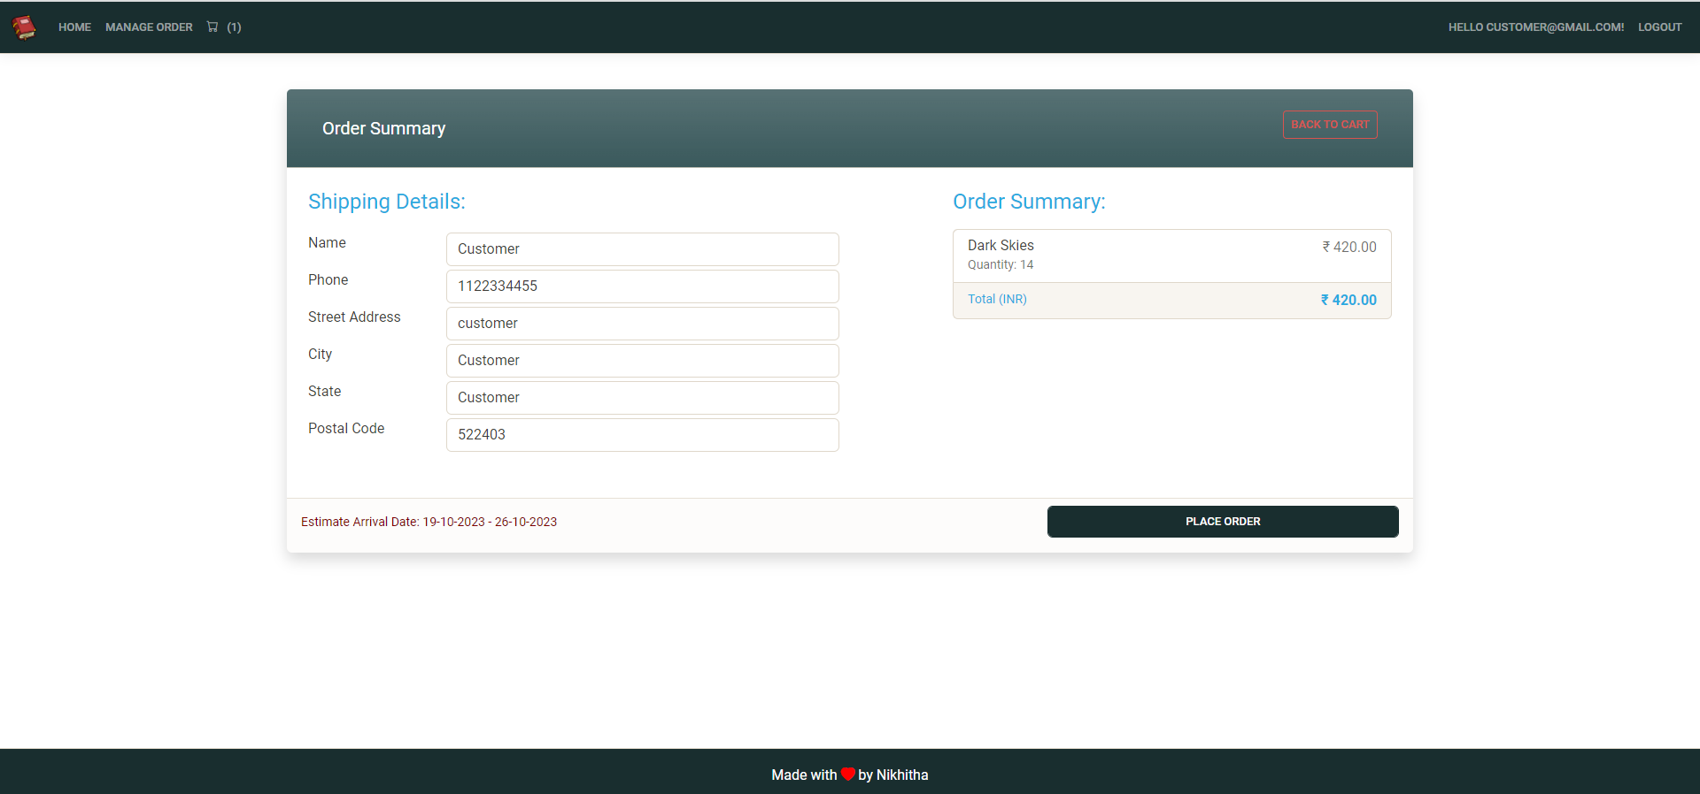
Summary Page – In Shopping cart page when we click on Summary button it redirects to this page (summary of placing order)

Slide 21
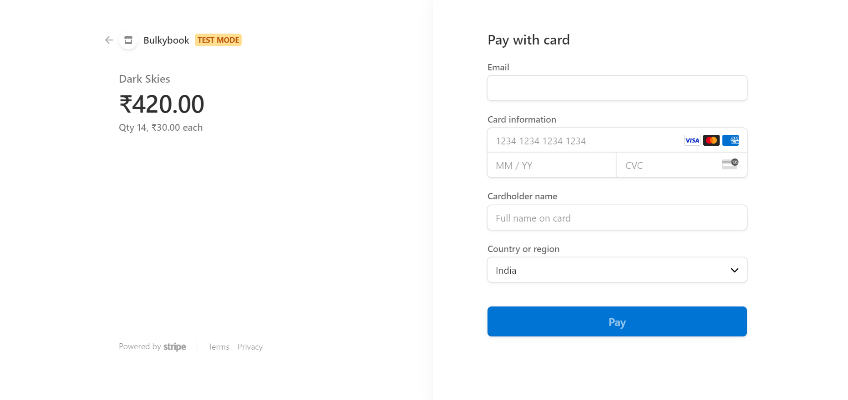
When we click on place order in summary page it redirects to Stripe payment

Slide 22
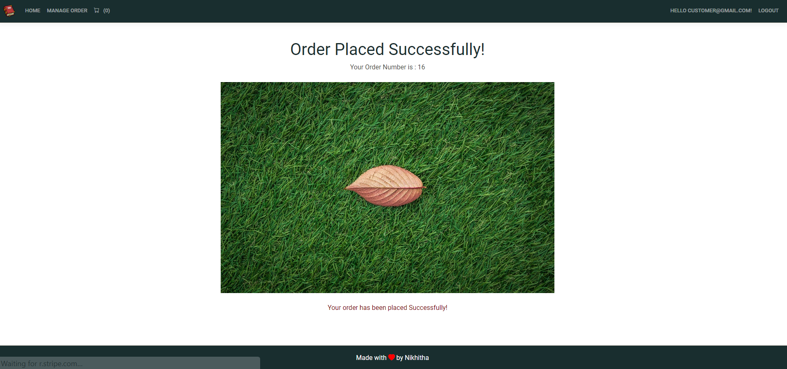
After Successful payment it redirects to this page showing that
“Order Placed Successfully!”

Slide 23
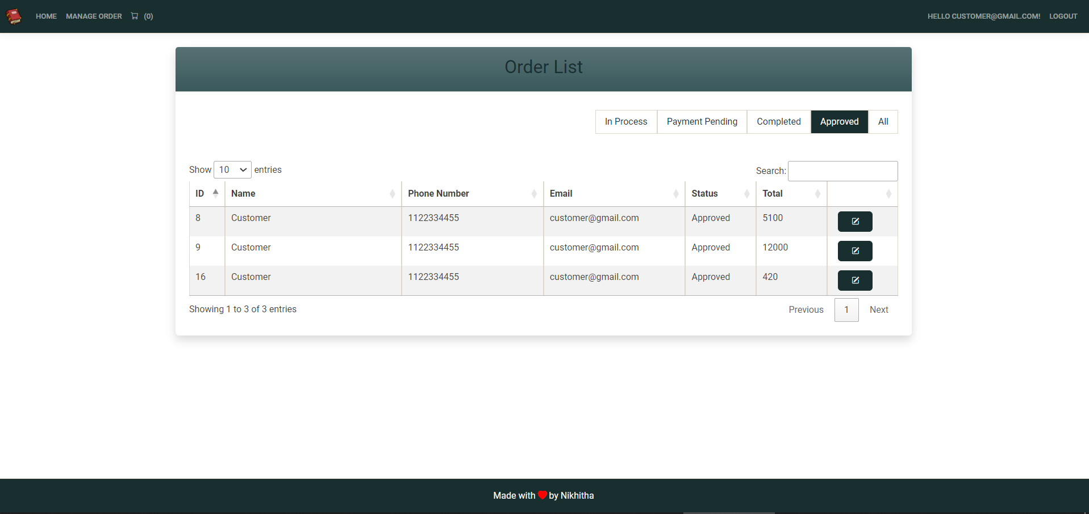
Manage Order Page – Here the login user can see his/her orders . Here we have button to filter the orders based on payment and approval status

Slide 24
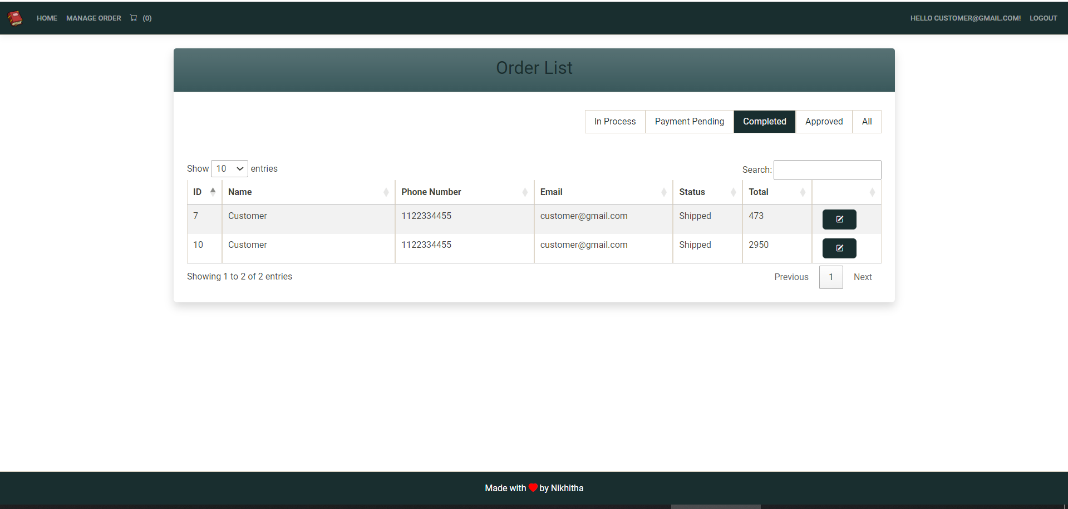
Orders which are completed - shipped

Slide 25
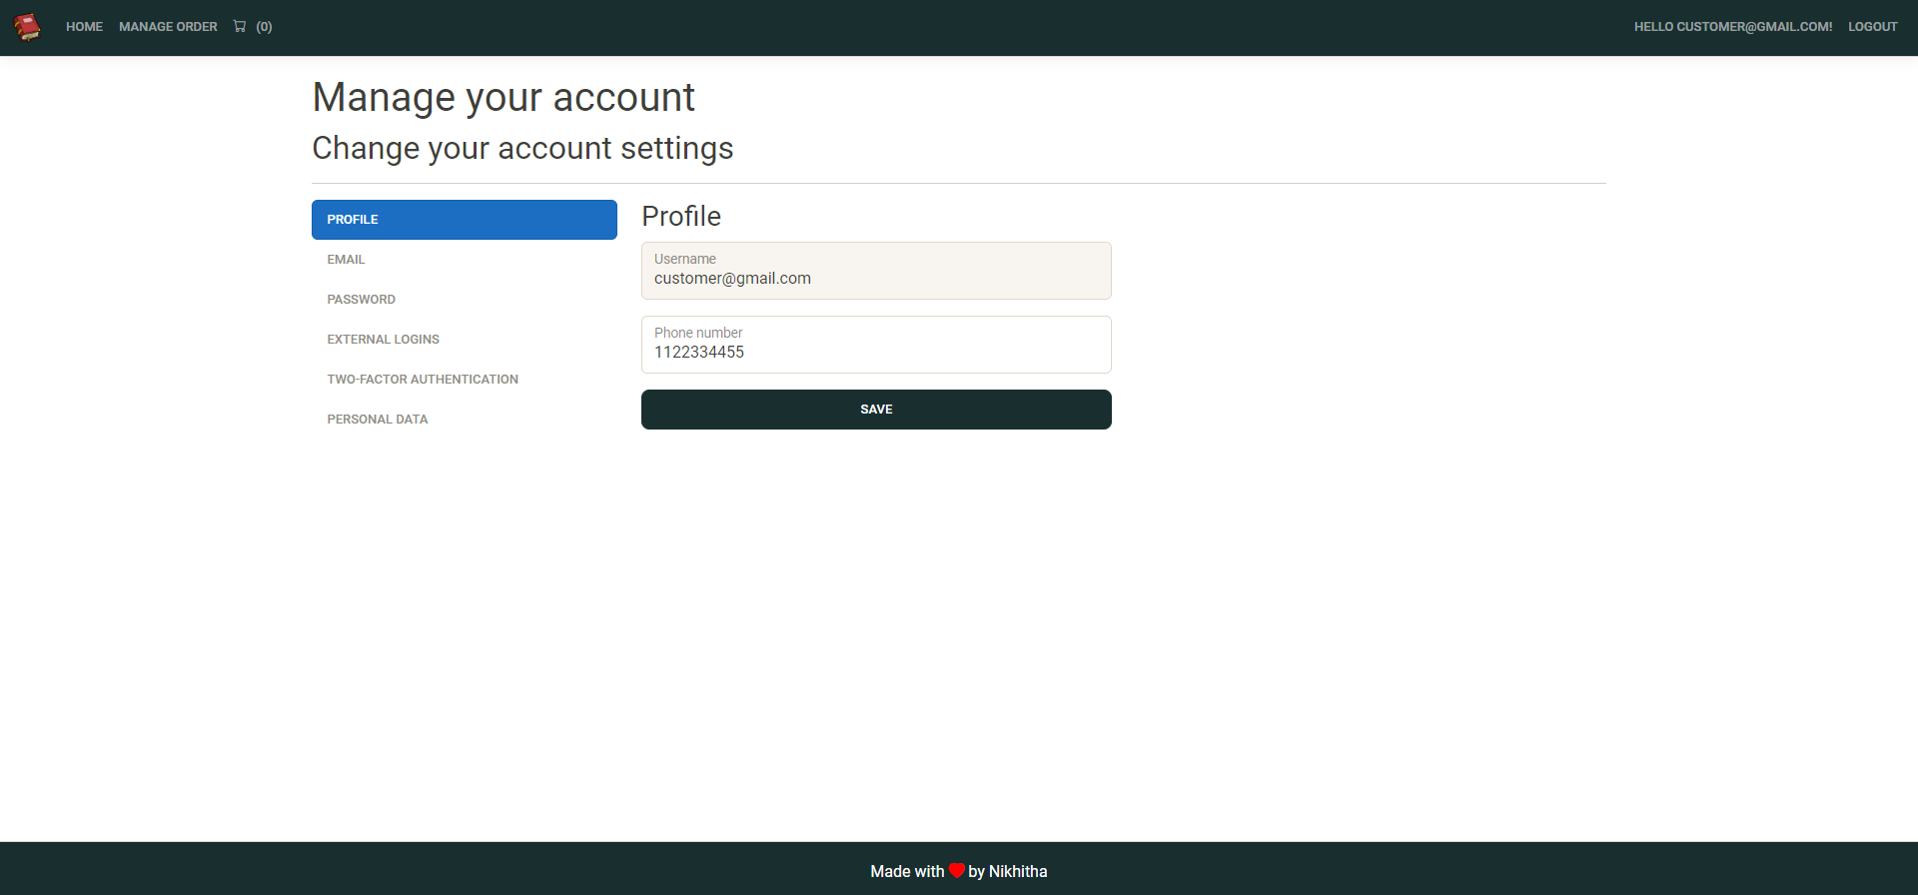
Manage Your Account Page – Here user can edit their details

Slide 26
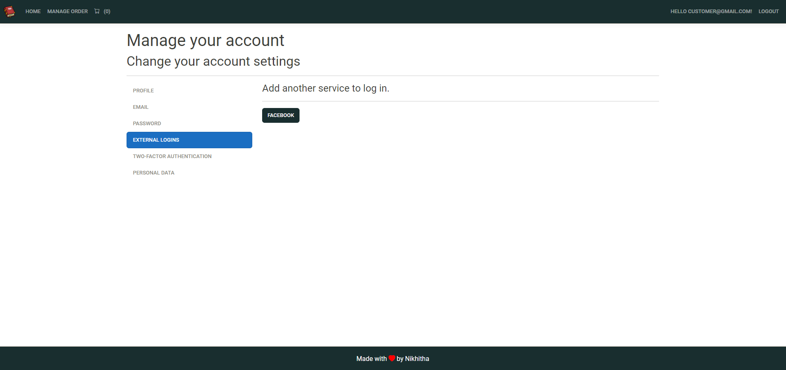

Slide 27
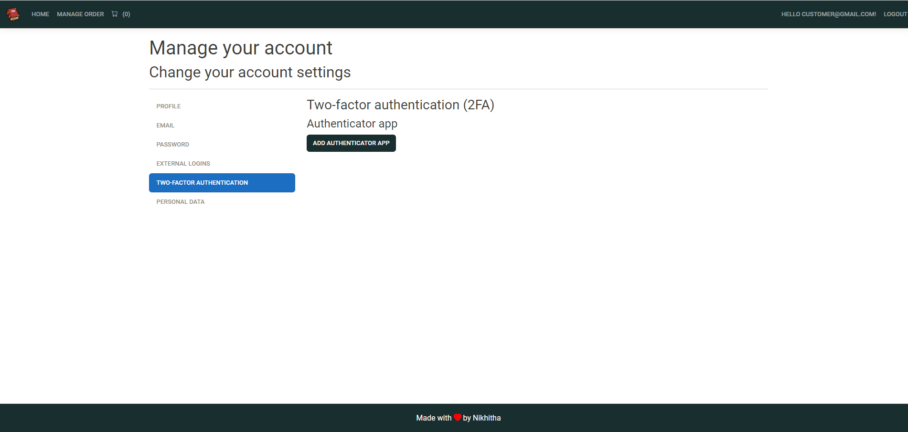

Slide 28
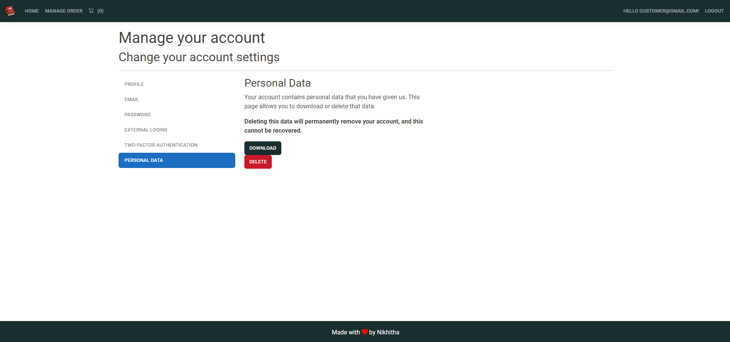

Slide 29
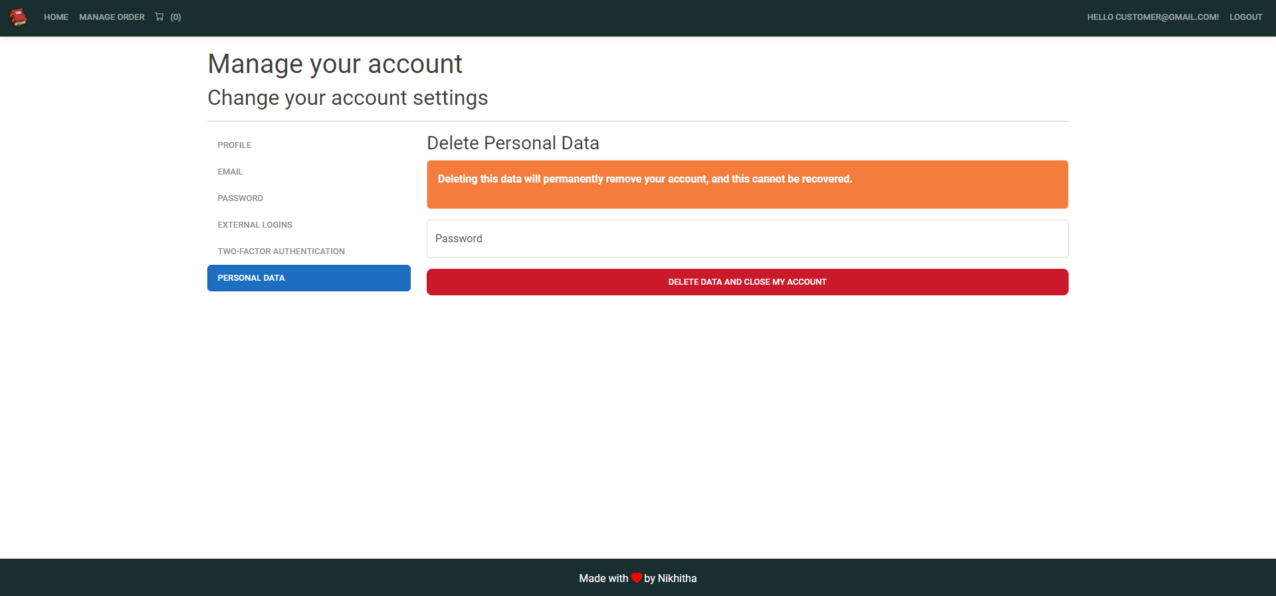

Slide 30
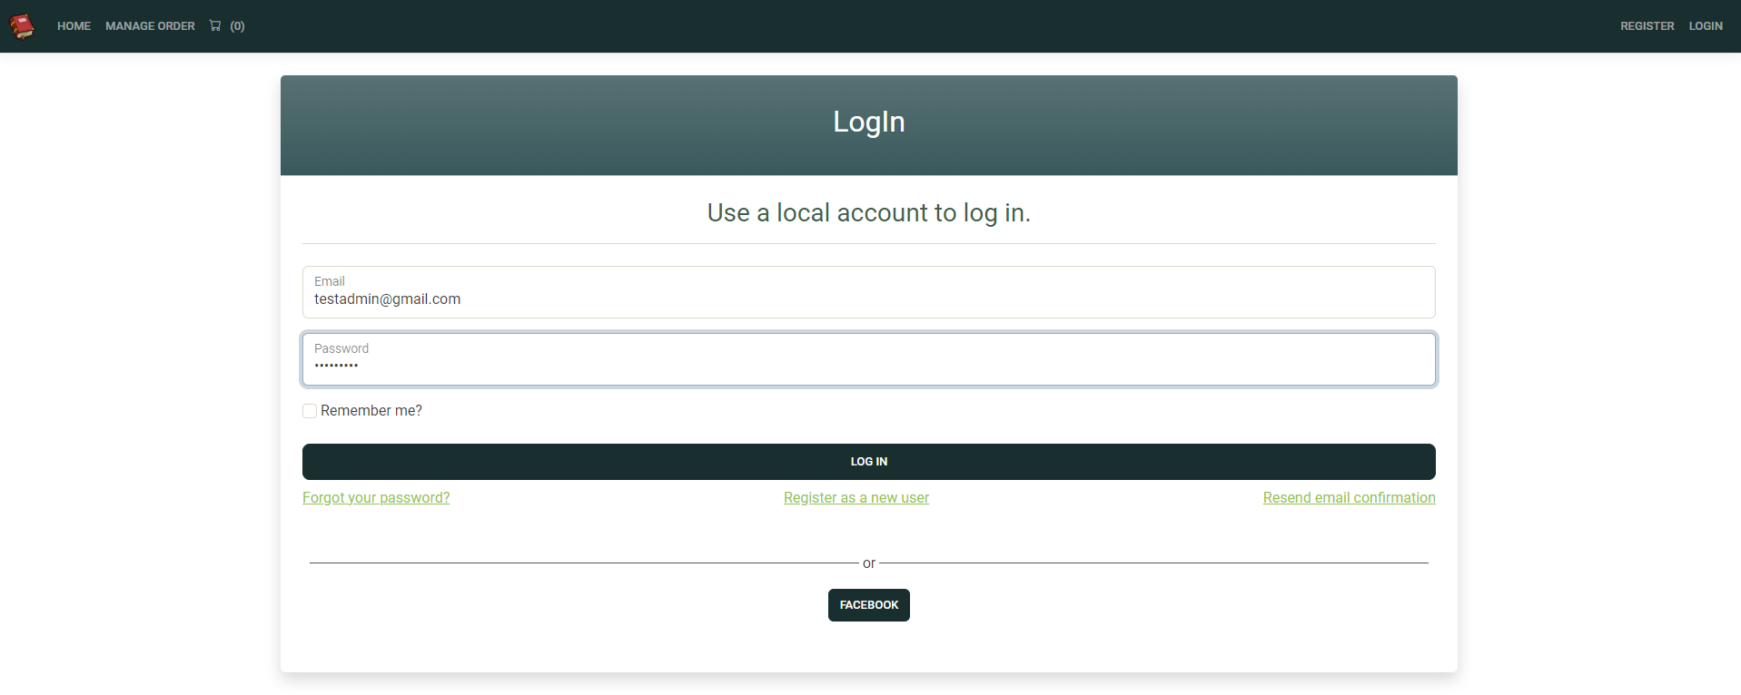
Login As Admin

Slide 31
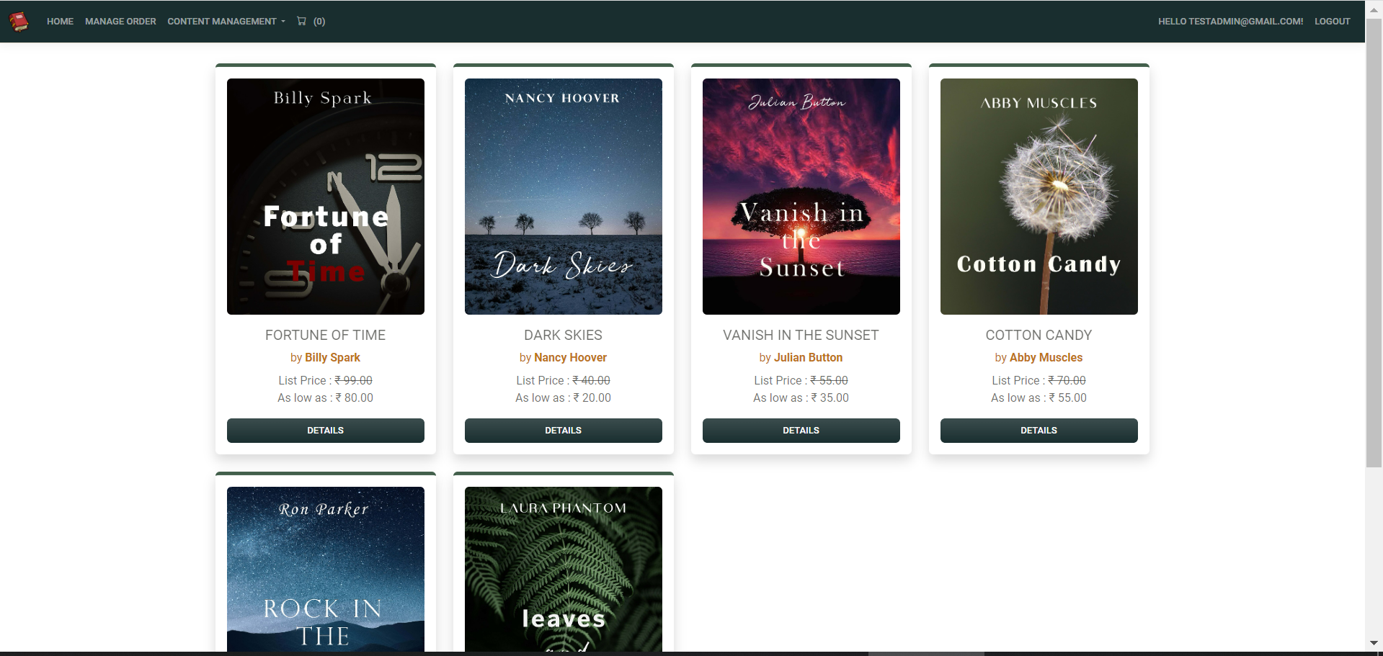
Here we can observe “Content Management” when we login as Admin

Slide 32


Slide 33
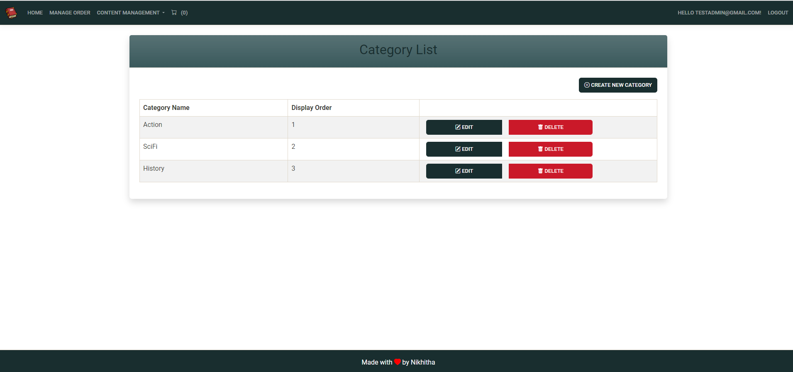
Admin has the access to Create/Update/Delete the Categories of Books

Slide 34
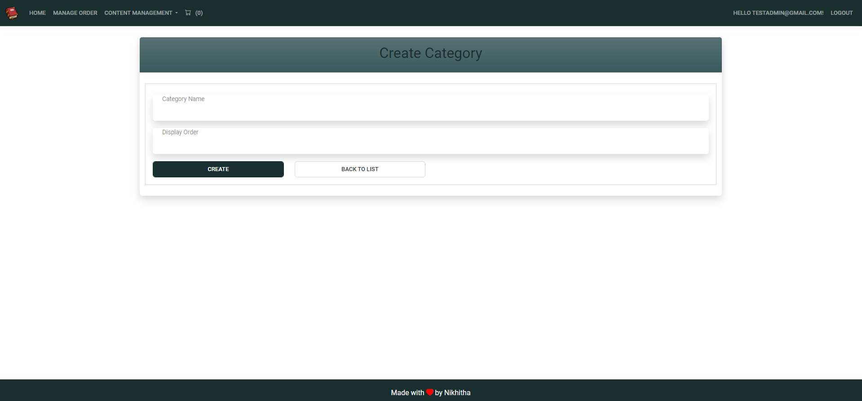
Create Category Page

Slide 35
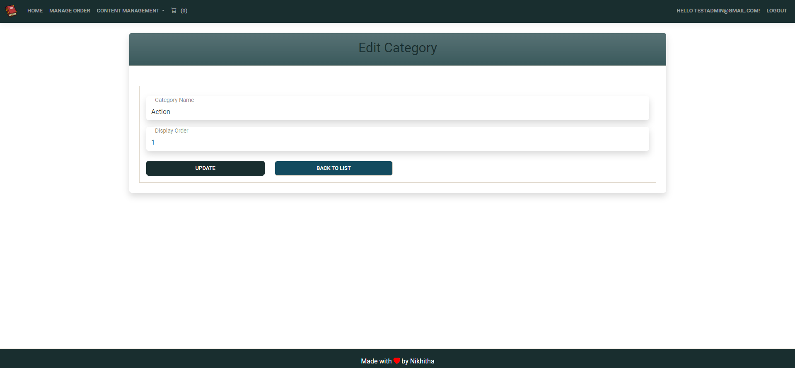
Edit Category Page

Slide 36
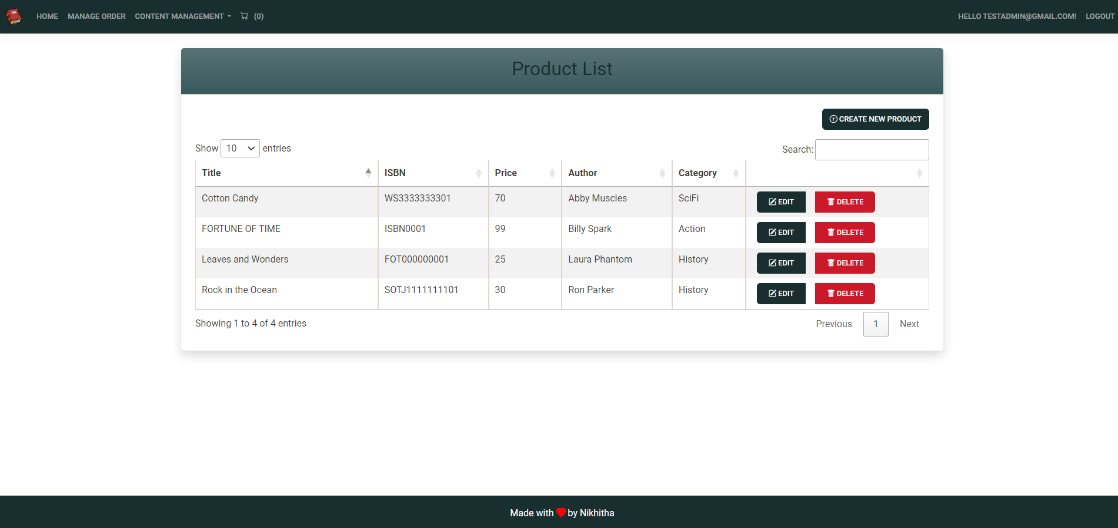
Product List Page : It shows us the list of products present in the website

Slide 37
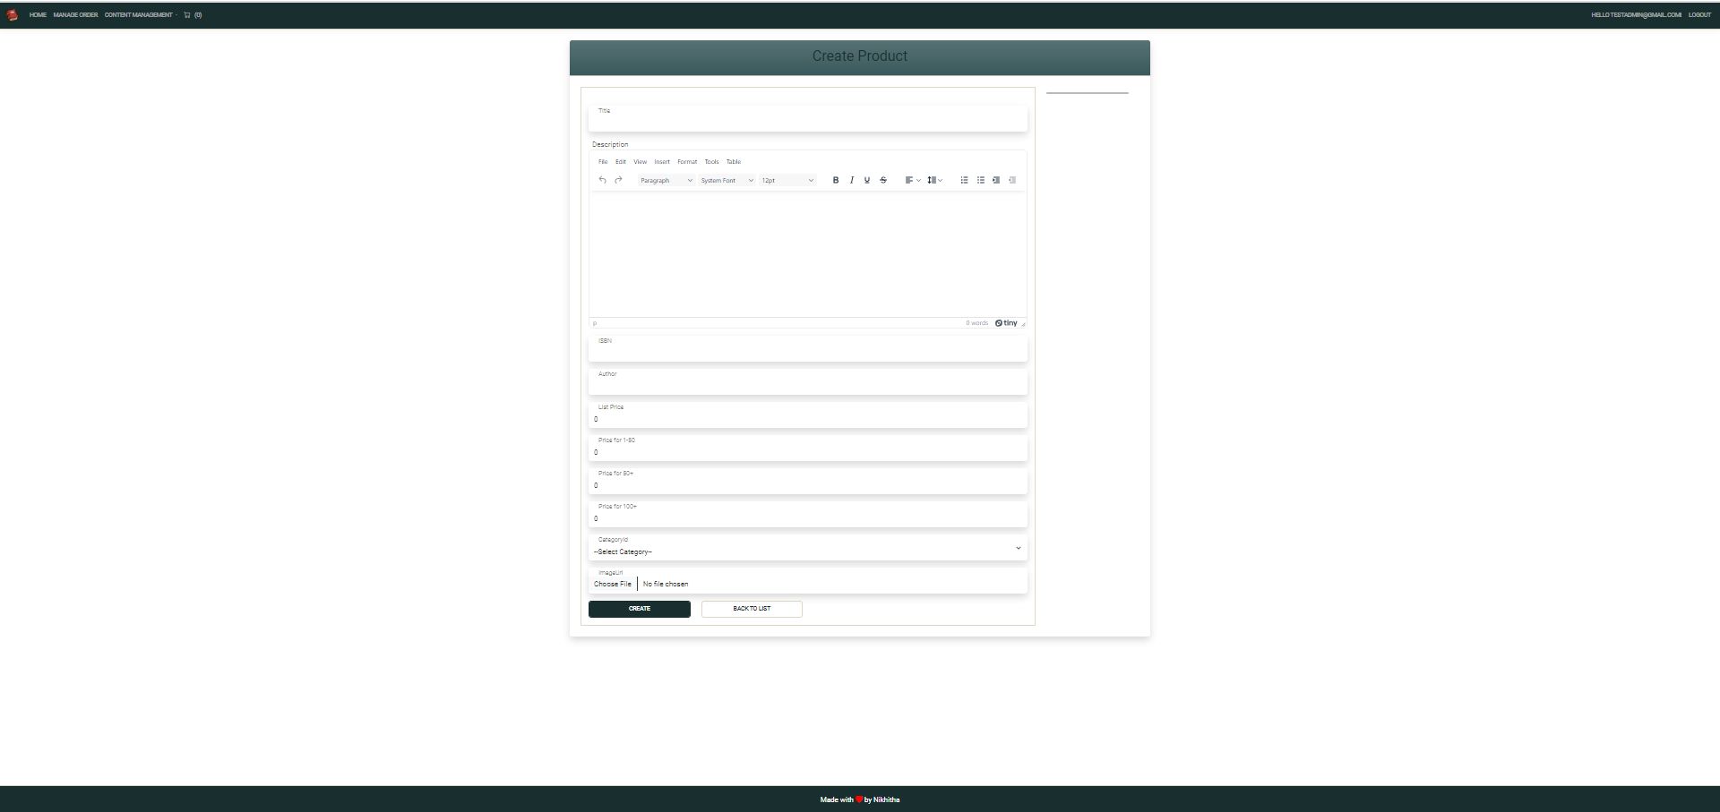
Create Product :
For Description – we used third-party tiny rich text editor

Slide 38
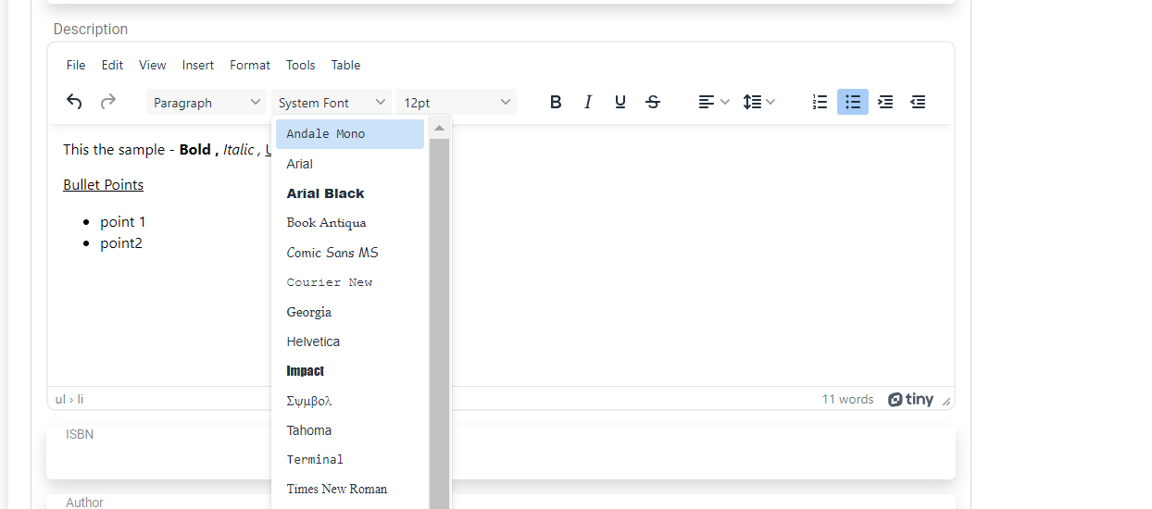
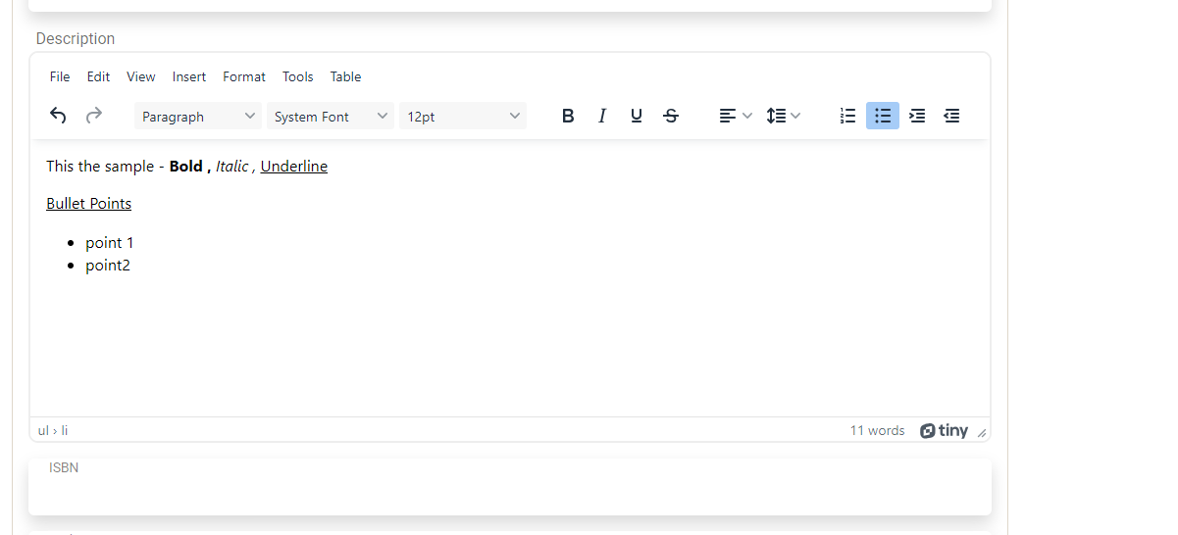

Slide 39
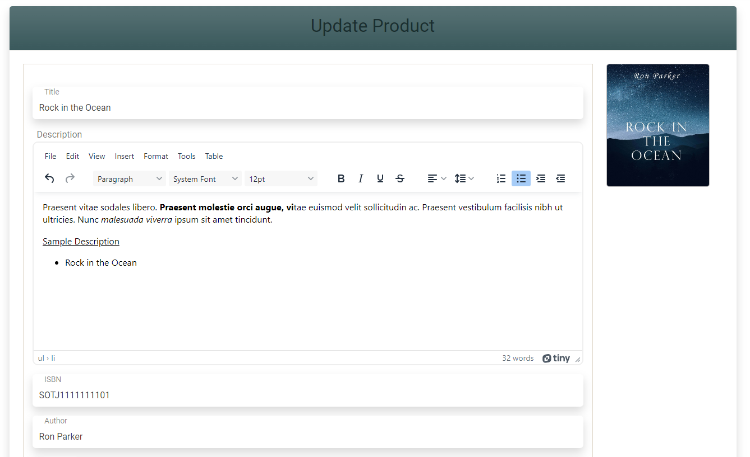
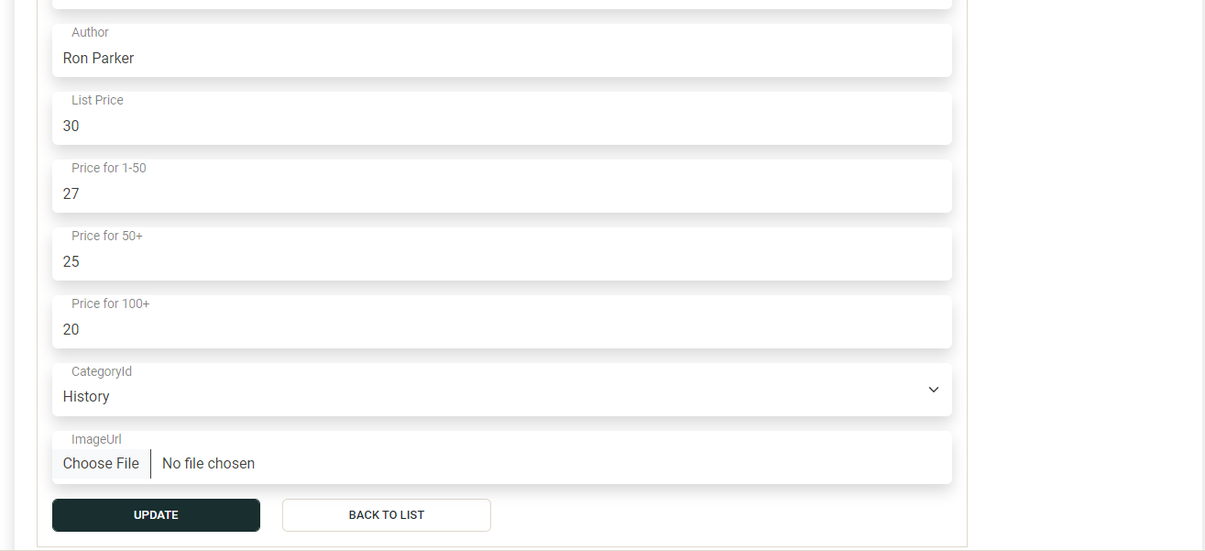
Update Product Item : Here we can update image as well

Slide 40
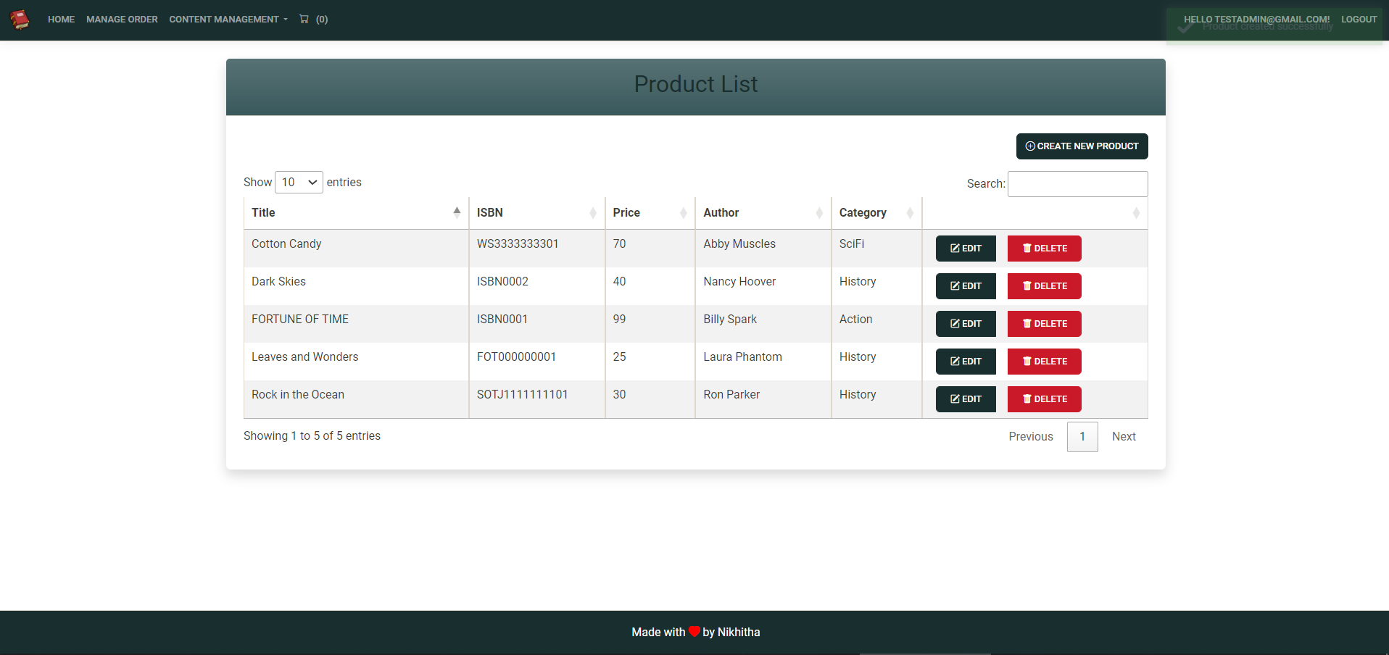

Slide 41
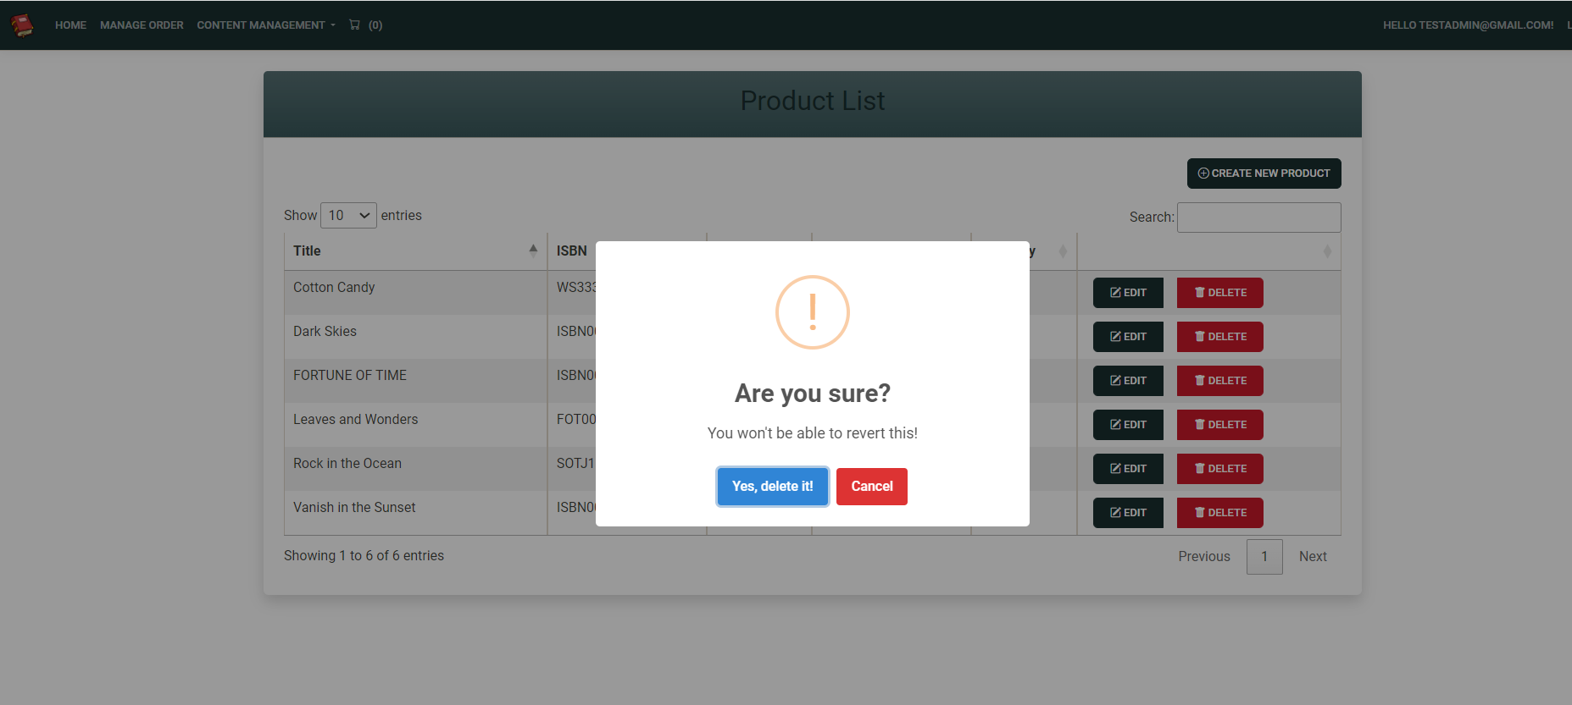
Sweet Alerts : For deleting the product

Slide 42
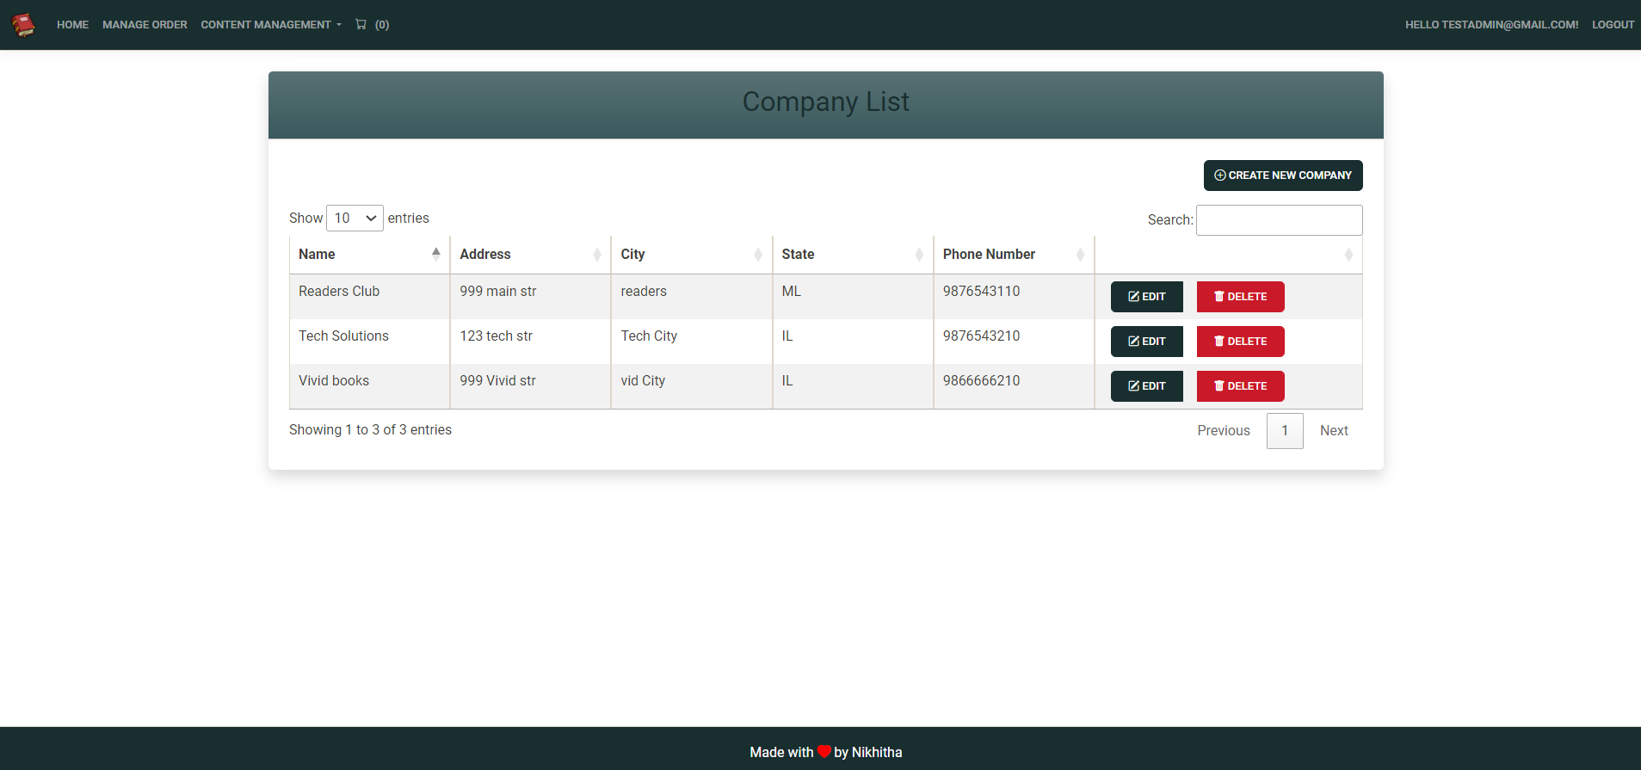
Company List Page – Associated Companies for the BULY BOOK Website

Slide 43
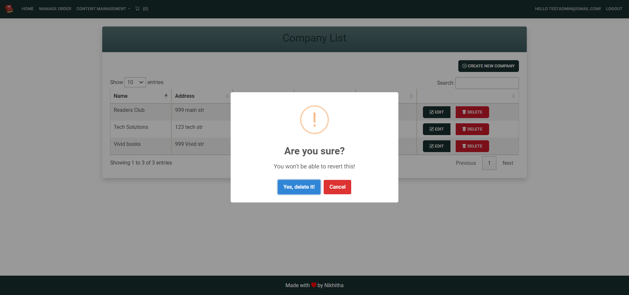

Slide 44
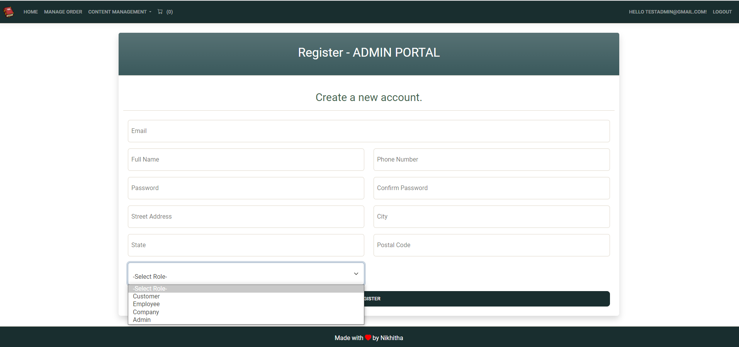
Admin has the access to create new user(Employee/Company)

Slide 45
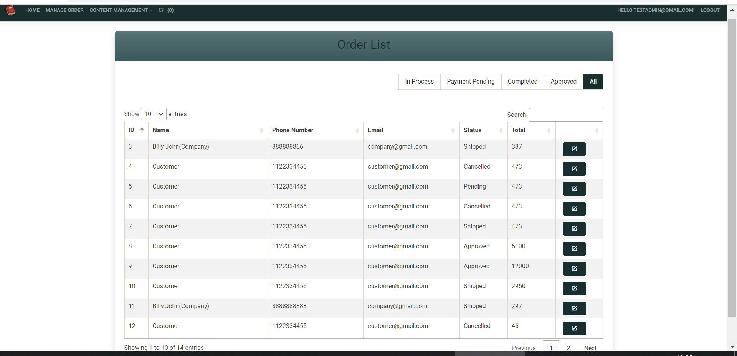
Orders Page - Admin

Slide 46
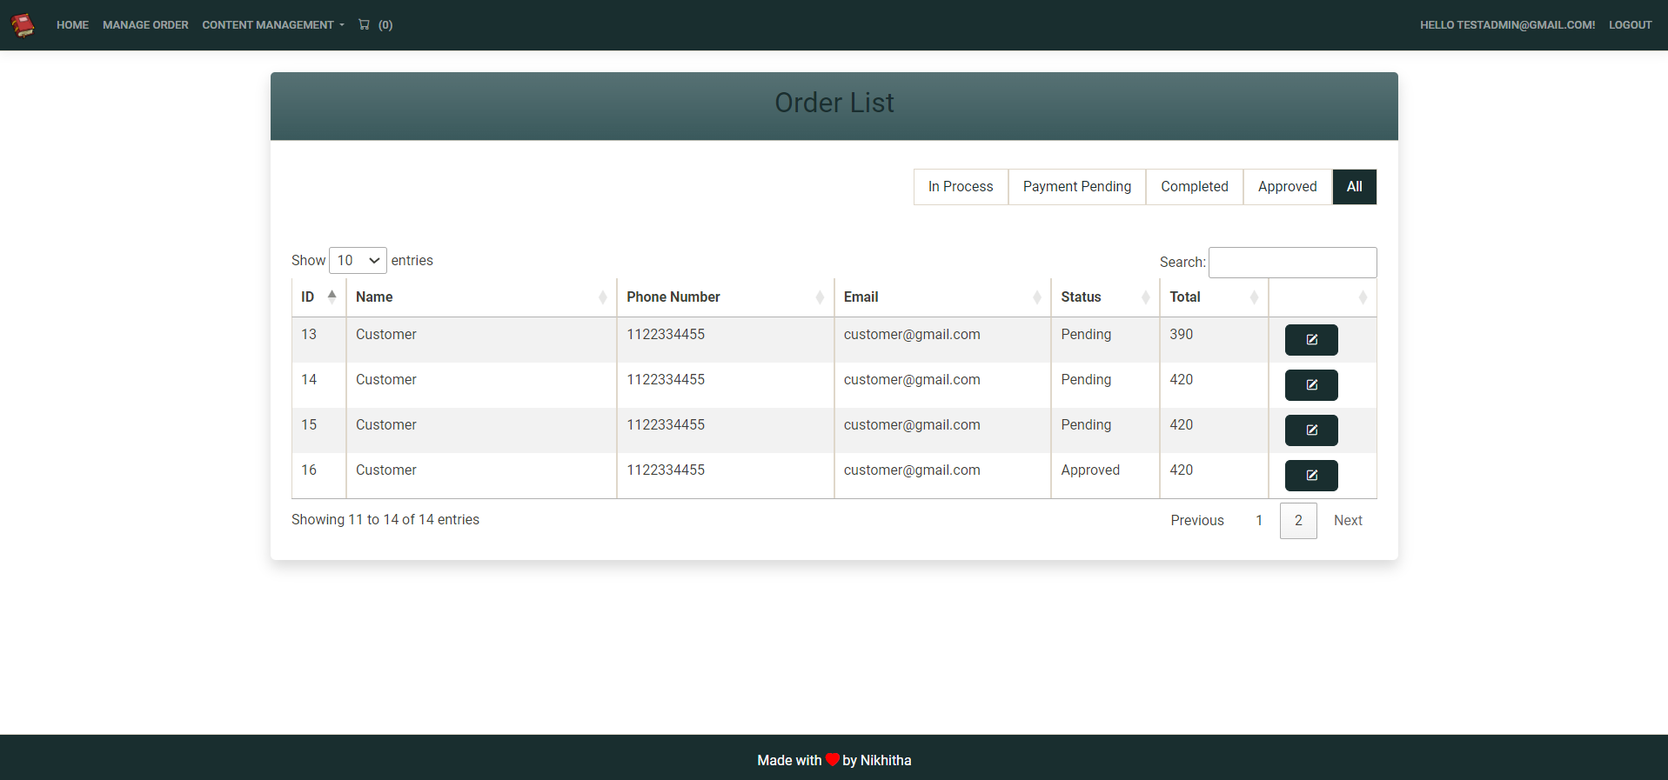

Slide 47
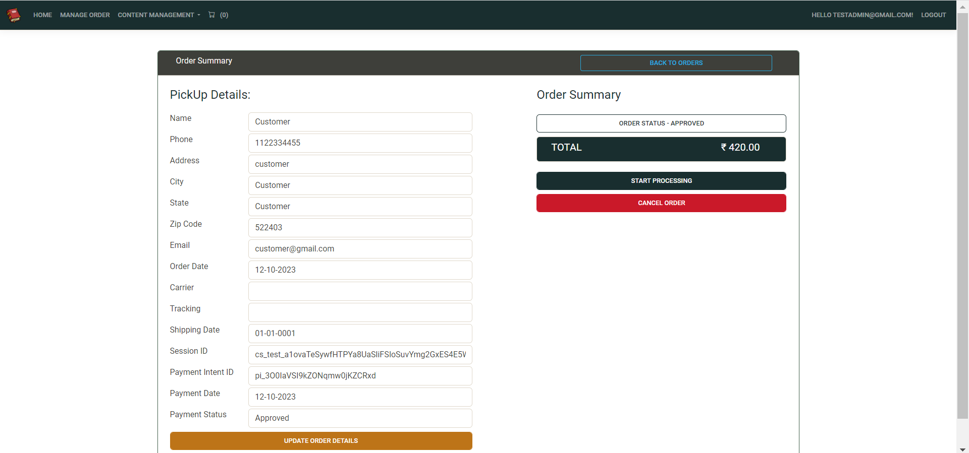
When we click on details of Order we redirect to this page which shows the order summary

Slide 48
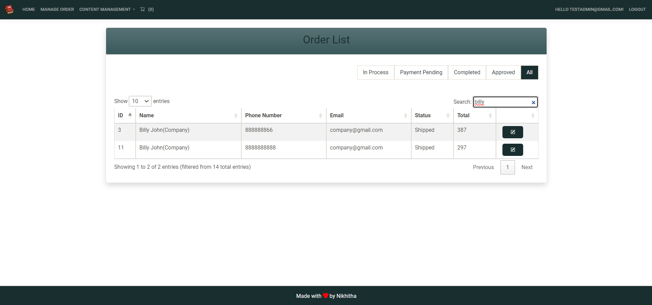
Implemented DataTables for Searching, Sorting , Pagination

Slide 49
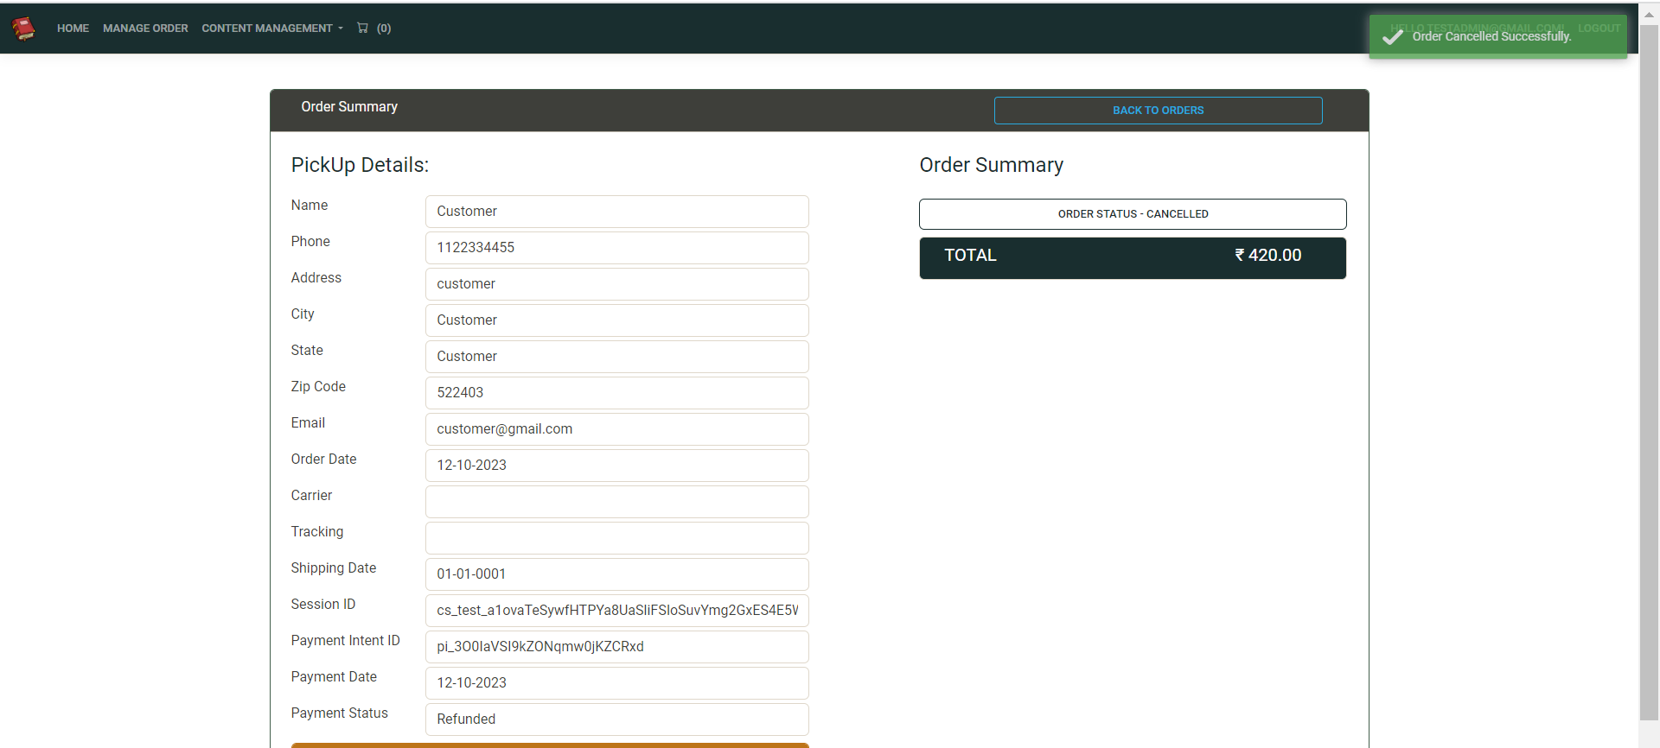
Toaster Notifications & Order management by Admin

Slide 50
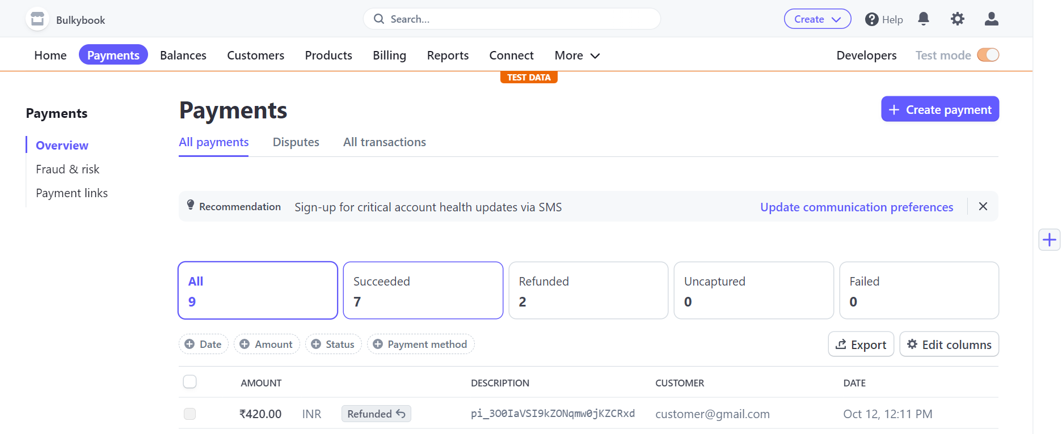
Stripe Website – Test Mode

Slide 51
Tag Helpers
Tag Helpers are introduced with ASP.NET Core.
Tag Helpers enable server-side code to participate in creating and rendering HTML elements.
Tag Helpers are very focused around the html elements and much more natural to use.

Slide 52
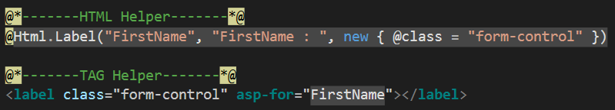
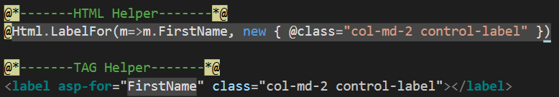
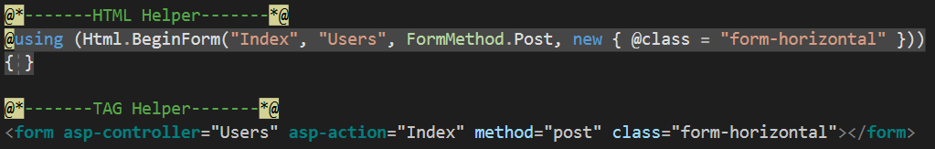
Tag Helpers Example

Slide 53
Action Result in MVC
Action Result | Helper Method | Description
ViewResult | View | Renders a view as a Web page.
PartialViewResult | PartialView | Renders a partial view, which defines a section of a view that can be rendered inside another view.
RedirectResult | Redirect | Redirects to another action method by using its URL.
RedirectToRouteResult | RedirectToAction RedirectToRoute | Redirects to another action method.
ContentResult | Content | Returns a user-defined content type.
JsonResult | Json | Returns a serialized JSON object.
JavaScriptResult | JavaScript | Returns a script that can be executed on the client.
FileResult | File | Returns binary output to write to the response.
EmptyResult | (None) | Represents a return value that is used if the action method must return a null result (void).

Slide 54
VIEWBAG
VIEWDATA
TEMPDATA
ViewBag transfers data from the Controller to View, not vice-versa. Ideal for situations in which the temporary data is not in a model.
ViewBag is a dynamic property that takes advantage of the new dynamic features in C# 4.0
Any number of properties and values can be assigned to ViewBag
The ViewBag's life only lasts during the current http request. ViewBag values will be null if redirection occurs.
ViewBag is actually a wrapper around ViewData.
ViewData transfers data from the Controller to View, not vice-versa. Ideal for situations in which the temporary data is not in a model.
ViewData is derived from ViewDataDictionary which is a dictionary type.
ViewData value must be type cast before use.
The ViewData's life only lasts during the current http request. ViewData values will be null if redirection occurs.
TempData can be used to store data between two consecutive requests.
TempData internaly use Session to store the data. So think of it as a short lived session.
TempData value must be type cast before use. Check for null values to avoid runtime error.
TempData can be used to store only one time messages like error messages, validation messages.
ViewBag internally inserts data into ViewData dictionary. So the key of ViewData and property of ViewBag must NOT match

Slide 55
VIEWMODEL
ViewModel contain fields that are represented in the view
ViewModel can have specific validation rules using data annotations.
ViewModel can have multiple entities or objects from different data models or data source.
ViewModel helps to implement strongly typed views.

Slide 56
In the Model-View-Controller (MVC) design pattern, the Model represents the data and the business logic, while the ViewModel is a specific type of model that is tailored for the view.
The Model is responsible for retrieving and storing data, and for performing any necessary calculations or logic. It is the source of truth for the application's data.
The ViewModel, on the other hand, is a representation of the Model that is optimized for the view. It may include additional properties or methods that are specifically designed to support the view's requirements.
In summary, the Model represents the application's data and logic, while the ViewModel is a representation of that data that is optimized for the view.

Slide 57
STRONGLY TYPED VIEWS
The view which binds to a specific type of ViewModel is called as Strongly Typed View.
By specifying the model, the Visual studio provides the intellisense and compile time checking of type.

Slide 58
Pending
ORDER STATUS MANAGMENT
In Process
Submitted
Automatic /
Payment Successful
When order is
being cooked
When order is
Picked Up.
When order is
Ready for Pickup
Ready for Pickup
Completed
KITCHEN
MANAGER
KITCHEN
MANAGER
FRONT DESK
MANAGER
Submitted
In Process
FRONT DESK
MANAGER
Cancel or Refund order
Manage Order
Refund / Cancel
Ready For Pickup
Completed
Cancelled
Order List

Slide 59

ORDER STATUS MANAGMENT
Makes Payment
Order Confirmation
Processing
Shipped
Individual
Customer
Status - Pending
Payment - Pending
Status - Approved
Payment - Approved
Status - Processing
Payment - Approved
Status - Shipped
Payment - Approved

Slide 60
ORDER STATUS MANAGMENT
Makes Payment
Order Confirmation
Processing
Shipped
Customer
Status - Pending
Payment - Pending
Status - Approved
Payment - Approved
Status - Processing
Payment - Approved
Status - Shipped
Payment - Approved
Order Confirmation
Processing
Makes
Payment
Shipped
Company have 30days
to make payment
after order is shipped
Company
Status - Approved
Payment - ApprovedForDelayedPayment
Status - Processing
Payment - ApprovedForDelayedPayment
Status - Shipped
Payment - ApprovedForDelayedPayment
Status - Shipped
Payment - Approved

